Slide 1

Starfish: A Self-tuning System for Big Data Analytics

Slide 2


Analysis in the Big Data Era
Massive Data
Data
Analysis
Insight
Key to Success = Timely and Cost-Effective Analysis

Slide 3

Hadoop MapReduce Ecosystem
Popular solution to Big Data Analytics
Java / C++ /
R / Python
Elastic
MapReduce
Pig
Hive
Jaql
Oozie
Hadoop
MapReduce Execution Engine
HBase
Distributed File System
Notes:
Analytics in Hadoop involves loading data as files and
running parallel MR computations to interpret and process the data.
Several systems have been built on top of Hadoop to satisfy user needs and preferences.

Slide 4
Practitioners of Big Data Analytics
Who are the users?
Data analysts, statisticians, computational scientists…
Researchers, developers, testers…
You!
Who performs setup and tuning?
The users!
Usually lack expertise to tune the system
Notes:
Users: computational analysts, system researchers, and business analysts

Slide 5
Tuning Challenges
Heavy use of programming languages for MapReduce programs (e.g., Java/python)
Data loaded/accessed as opaque files
Large space of tuning choices
Elasticity is wonderful, but hard to achieve (Hadoop has many useful mechanisms, but policies are lacking)
Terabyte-scale data cycles

Slide 6
Starfish: Self-tuning System
Our goal: Provide good performance automatically
Java / C++ /
R / Python
Elastic
MapReduce
Pig
Hive
Jaql
Oozie
Analytics System
Starfish
Hadoop
MapReduce Execution Engine
HBase
Distributed File System

Slide 7
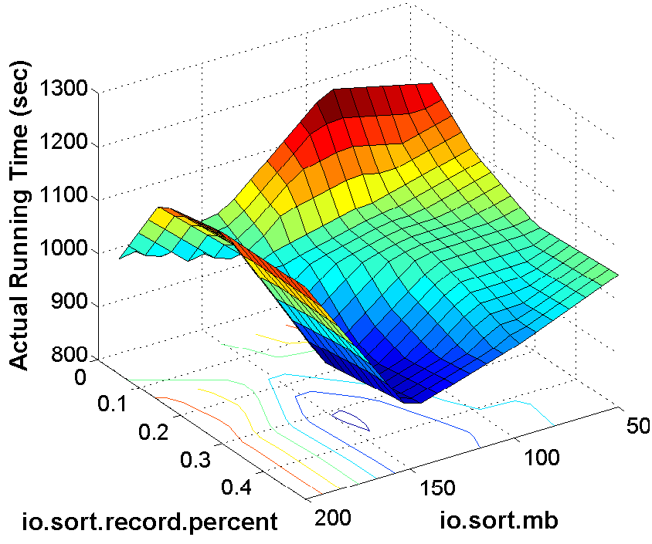

What are the Tuning Problems?
Job-level MapReduce configuration
Cluster sizing
Data
layout
tuning
J₁
J₂
J₃
Workflow optimization
Workload management
J₄

Slide 8
Starfish’s Core Approach to Tuning
Optimizers
Search through space of tuning choices
Cluster
Job
Data layout
Profiler
What-if Engine
Workflow
Collects concise
summaries of
execution
Workload
Estimates impact of hypothetical changes on execution
if Δ(conf. parameters) then what …?
if Δ(data properties) then what …?
if Δ(cluster properties) then what …?

Slide 9
Starfish Architecture
Workload Optimizer
Elastisizer
Profiler
What-if
Engine
Workflow Optimizer
Job Optimizer
Data Manager
Metadata
Mgr.
Intermediate
Data Mgr.
Data Layout & Storage Mgr.
Notes:
3 levels of workload granularities create 3 levels of tuning opportunities that form the basis for the starfish architecture.
In particular, we have organized the components into 3 categories.
Provide an overview of the main challenges and opportunities that exists in the 3 tuning levels.

Slide 10
MapReduce Job Execution
job j = < program p, data d, resources r, configuration c >
split 0
map
split 2
map
reduce
out 0
split 1
map
split 3
map
reduce
Out 1
Two Map Waves
One Reduce Wave

Slide 11
What Controls MR Job Execution?
job j = < program p, data d, resources r, configuration c >
Space of configuration choices:
Number of map tasks
Number of reduce tasks
Partitioning of map outputs to reduce tasks
Memory allocation to task-level buffers
Multiphase external sorting in the tasks
Whether output data from tasks should be compressed
Whether combine function should be used

Slide 12
Effect of Configuration Settings
Rules-of-thumb settings
Two-dimensional projection of a multi-dimensional surface
(Word Co-occurrence MapReduce Program)
Use defaults or set manually (rules-of-thumb)
Rules-of-thumb may not suffice
Notes:
Parameters: number of map and reduce tasks, memory buffers, or use of compression
Job: cpu vs io computation, how selective the map is
Data: num unique values, key-value distributions
Cluster: num task slots, available task memory

Slide 13
MapReduce Job Tuning in a Nutshell
Goal:
Challenges: p is an arbitrary MapReduce program; c is high-dimensional; …
Profiler
What-if Engine
Optimizer
Runs p to collect a job profile (concise execution summary) of <p,d₁,r₁,c₁>
Given profile of <p,d₁,r₁,c₁>, estimates virtual profile for <p,d₂,r₂,c₂>
Enumerates and searches through the optimization space S efficiently
Notes:
Responsibility is given a job to execute on a particular data set on a particular cluster, to search through the high-dimensional space of parameter settings, in order to find the one with the best estimated performance.
Dynamic instrumentation: collect run-time monitoring information to build a job profile: a concise representation of the job execution.
Use existing methods (e.g., simulated annealing, stochastic gradient descent)

Slide 14
Job Profile
Concise representation of program execution as a job
Records information at the level of “task phases”
Generated by Profiler through measurement or by the What-if Engine through estimation
map
Serialize,
Partition
Memory Buffer
Sort,
[Combine],
[Compress]
split
Merge
DFS
Read
Map
Collect
Spill
Merge

Slide 15
Job Profile Fields
Dataflow: amount of data flowing through task phases
Map output bytes
Number of spills
Number of records in buffer per spill
Costs: execution times at the level of task phases
Read phase time in the map task
Map phase time in the map task
Spill phase time in the map task
Dataflow Statistics: statistical information about dataflow
Width of input key-value pairs
Map selectivity in terms of records
Map output compression ratio
Cost Statistics: statistical information about resource costs
I/O cost for reading from local disk per byte
CPU cost for executing the Mapper per record
CPU cost for uncompressing the input per byte

Slide 16
Generating Profiles by Measurement
Goals
Have zero overhead when profiling is turned off
Require no modifications to Hadoop
Support unmodified MapReduce programs written in Java or Hadoop Streaming/Pipes (Python/Ruby/C++)
Approach: Dynamic (on-demand) instrumentation
Event-condition-action rules are specified (in Java)
Leads to run-time instrumentation of Hadoop internals
Monitors task phases of MapReduce job execution
We currently use Btrace (Hadoop internals are in Java)

Slide 17
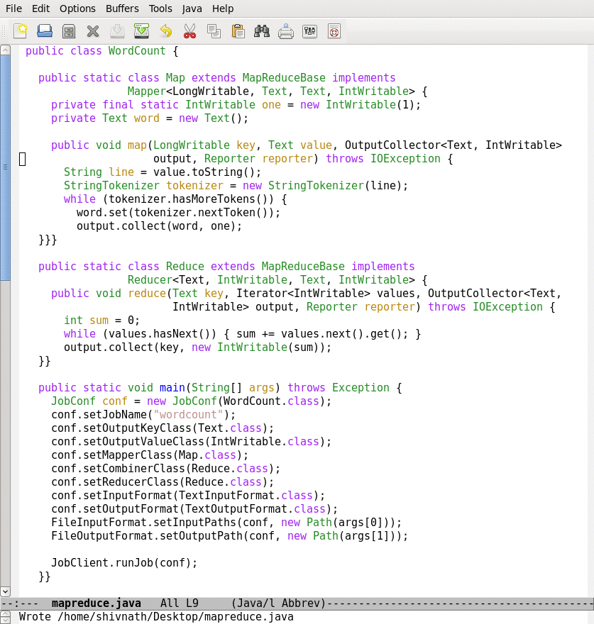
Generating Profiles by Measurement
JVM
JVM
Enable Profiling
split 0
map
reduce
out 0
raw data
ECA rules
raw data
JVM
map profile
reduce profile
split 1
map
Use of Sampling
Profile fewer tasks
Execute fewer tasks
raw data
job profile
JVM = Java Virtual Machine, ECA = Event-Condition-Action

Slide 18
What-if Engine
Possibly Hypothetical
Job
Profile
<p, d₁, r₁, c₁>
Input Data
Properties
<d₂>
Cluster
Resources
<r₂>
Configuration
Settings
<c₂>
What-if Engine
Job Oracle
Virtual Job Profile for <p, d₂, r₂, c₂>
Task Scheduler Simulator
Properties of Hypothetical job

Slide 19
Virtual Profile Estimation
Given profile for job j = <p, d₁, r₁, c₁>
estimate profile for job j' = <p, d₂, r₂, c₂>
Profile for j
(Virtual) Profile for j'
Dataflow
Statistics
Input
Data d₂
Confi-guration c₂
Cardinality
Models
Dataflow
Statistics
Cost
Statistics
Resources
r₂
White-box Models
Cost
Statistics
Dataflow
Relative
Black-box
Models
Dataflow
White-box Models
Costs
Costs

Slide 20
Job Optimizer
Job
Profile
<p, d₁, r₁, c1>
Input Data
Properties
<d₂>
Cluster
Resources
<r₂>
Just-in-Time Optimizer
Subspace Enumeration
What-if
calls
Recursive Random Search
Best Configuration
Settings <c_{opt}> for <p, d₂, r₂>

Slide 21
Workflow Optimization Space
Optimization Space
Physical
Logical
Job-level Configuration
Dataset-level Configuration
Vertical Packing
Partition Function Selection
Join Selection
Inter-job
Inter-job

Slide 22
Optimizations on TF-IDF Workflow
D0
<{D},{W}>
D0
<{D},{W}>
…
…
…
M1
R1
Partition:{D}
Sort: {D,W}
Reducers= 50
Compress = off
Memory = 400
…
J1
J1, J2
M1
R1
M2
R2
D1
<{D, W},{f}>
Logical
Optimization
Physical
Optimization
…
…
M2
R2
D2
<{D},{W, f, c}>
Reducers= 20
Compress = on
Memory = 300
…
J2
…
<{D},{W, f, c}>
M3
R3
M4
D2
J3, J4
…
…
M3
R3
M4
J3, J4
<{W},{D, t}>
Legend
D = docname f = frequency
W = word c = count
t = TF-IDF
D4
…
D4
<{W},{D, t}>
…

Slide 23
New Challenges
What-if challenges:
Support concurrent job execution
Estimate intermediate data properties
Optimization challenges
Interactions across jobs
Extended optimization space
Find good configuration settings for individual jobs
Workflow
J1
J2
J3
J4

Slide 24
Cluster Sizing Problem
Use-cases for cluster sizing
Tuning the cluster size for elastic workloads
Workload transitioning from development cluster to production cluster
Multi-objective cluster provisioning
Goal
Determine cluster resources & job-level configuration parameters to meet workload requirements

Slide 25
Multi-objective Cluster Provisioning
Cloud enables users to provision clusters in minutes

Slide 26
Experimental Evaluation
Starfish (versions 0.1, 0.2) to manage Hadoop on EC2
Different scenarios: Cluster × Workload × Data
EC2 Node Type | CPU: EC2 units | Mem | I/O Perf. | Cost /hour | #Maps /node | #Reds/node | MaxMem /task
m1.small | 1 (1 x 1) | 1.7 GB | moderate | $0.085 | 2 | 1 | 300 MB
m1.large | 4 (2 x 2) | 7.5 GB | high | $0.34 | 3 | 2 | 1024 MB
m1.xlarge | 8 (4 x 2) | 15 GB | high | $0.68 | 4 | 4 | 1536 MB
c1.medium | 5 (2 x 2.5) | 1.7 GB | moderate | $0.17 | 2 | 2 | 300 MB
c1.xlarge | 20 (8 x 2.5) | 7 GB | high | $0.68 | 8 | 6 | 400 MB
cc1.4xlarge | 33.5 (8) | 23 GB | very high | $1.60 | 8 | 6 | 1536 MB

Slide 27
Experimental Evaluation
Starfish (versions 0.1, 0.2) to manage Hadoop on EC2
Different scenarios: Cluster × Workload × Data
Abbr. | MapReduce Program | Domain | Dataset
CO | Word Co-occurrence | Natural Lang Proc. | Wikipedia (10GB – 22GB)
WC | WordCount | Text Analytics | Wikipedia (30GB – 1TB)
TS | TeraSort | Business Analytics | TeraGen (30GB – 1TB)
LG | LinkGraph | Graph Processing | Wikipedia (compressed ~6x)
JO | Join | Business Analytics | TPC-H (30GB – 1TB)
TF | Term Freq. - Inverse Document Freq. | Information Retrieval | Wikipedia (30GB – 1TB)

Slide 28
Job Optimizer Evaluation
Hadoop cluster: 30 nodes, m1.xlarge
Data sizes: 60-180 GB

Slide 29
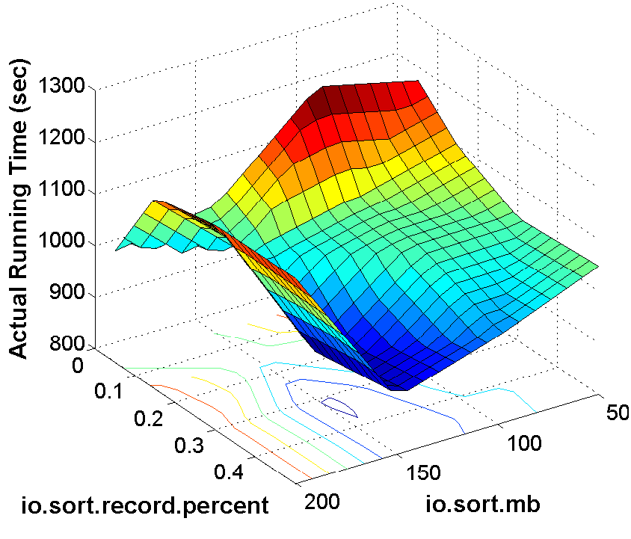
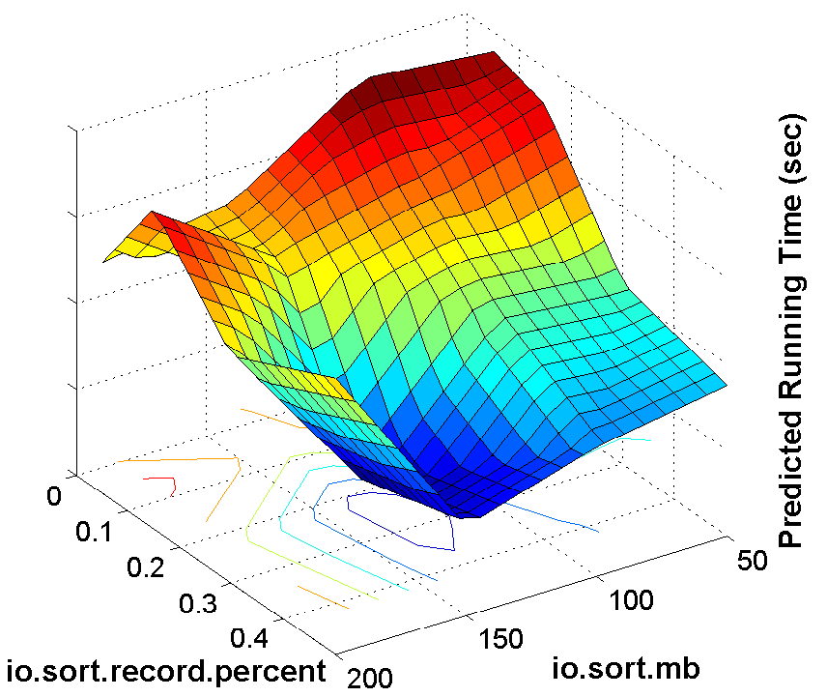
Estimates from the What-if Engine
Hadoop cluster: 16 nodes, c1.medium
MapReduce Program: Word Co-occurrence
Data set: 10 GB Wikipedia
True surface
Estimated surface

Slide 30
Profiling Overhead Vs. Benefit
Hadoop cluster: 16 nodes, c1.medium
MapReduce Program: Word Co-occurrence
Data set: 10 GB Wikipedia

Slide 31
Multi-objective Cluster Provisioning
Instance Type for Source Cluster: m1.large

Slide 32
More info: www.cs.duke.edu/starfish
Job-level MapReduce configuration
Cluster sizing
Data
layout
tuning
J₁
J₂
J₃
Workflow optimization
Workload management
J₄

